Slide 1
Microsoft Booking
Subtitle or speaker name

Slide 2
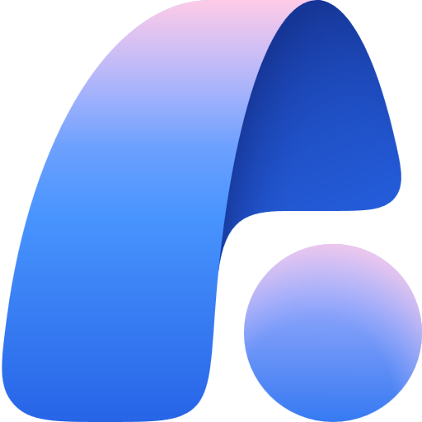
Bookings Overview
Bookings Support
Agenda
Behind the Scenes
Troubleshooting
Monitoring & Reporting

Slide 3
Bookings Overview

Slide 4

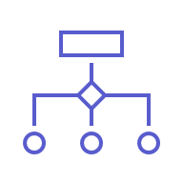



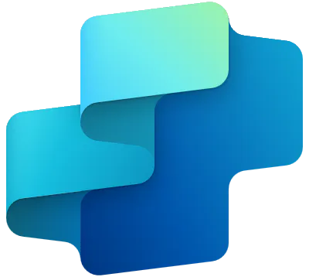
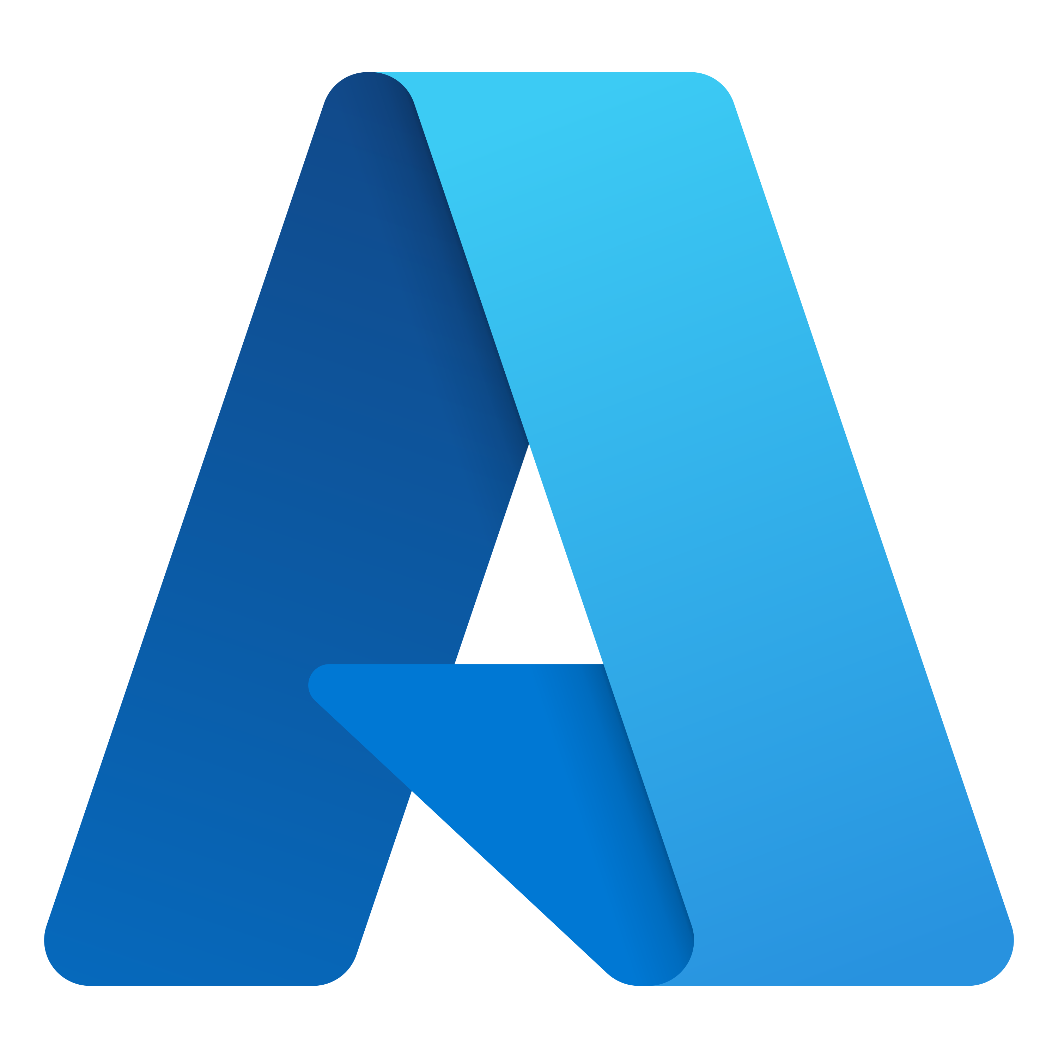
Agent Controls Model
Individual
Organizational
End Users
Makers
Developers
IT restricts makers to personal agents with read-only access based on content permissions
IT-approved makers build agents in secure, IT-managed environments and deploy them department-wide
Pro developers build and deploy enterprise-grade agents with org-standard ALM
Data protection, agent sharing & usage limits, and reporting & cost management
Notes:
A methodology on how to govern and manage agent creation using Zones.
Today when building agents organizations have a plethora of tools at Microsoft to help you govern and secure your agents such as the Microsoft 365 Admin Center, Power Platform Admin Center, Microsoft Purview, Microsoft Sentinel, and more. These admin centers and their accompanying capabilities enable IT departments to leverage data protection, agent sharing & usage limits, and reporting + cost management controls no matter which tool you use to build agents.
However, just as important as the tooling used to govern and secure your AI investment, is how you organize people and processes in your organization to leverage agents. Organizations have to distinguish between use cases through a mix of training, audits, and automated agent review cycles.
We recommend securing your AI by first analyzing who will have rights to consume and build agents and what agents they will be able to consume and how complex an agent that employee can build.
For example, we define zone 1 as the citizen development zone. This means that anyone in the organization should be able to build a personal agent, meaning it can't be shared with anyone else in the organization, and that agent should only have access to read knowledge and surface content to the end user that they already have rights to access. These agents are typically built in Microsoft 365 Agent Builder or in SharePoint meaning that developer build rights and sharing limits are controlled in either the Microsoft 365 Admin Center or in SharePoint Advanced Management, depending on how the agent was built.
In Zone 2 however, citizen developers can build agents with full CRUD capabilities because they've undergone IT sanctioned training to build more complex and widely shared agents. These agents are shared from the team level up to the departmental level via an IT managed agent store. Meaning the agent has been reviewed and approved by IT at the data connection, actions, security, and sharing levels with full visibility into the audit trails of the agents. These developers also follow ALM practices by first building agents in the development environment, moving to a test environment, and eventually putting the agent in production with IT sign off, ensuring a highly visible and secure development + deployment process.
Lastly, Zone 3 takes Zone 2 a step further by exclusively building and managing enterprise-wide agents. These are the most critical agents in your organization to secure due to how broadly these agents are shared, often times the knowledge/data these agents have access to, and the orchestration models these agents leverage. As such these agents must go through the full scrutiny of organization-standard ALM practices. These agents are often built by professional developers in collaboration with IT as they require custom coding capabilities and the highest quality agent security and deployment possible.

Slide 5
Agents security, governance, and operations
For End Users
For Makers
For Developers
 | Agents in the full DIY zone, zone 1, mean the citizen developer is responsible for the entire management lifecycle | Agents in the partnered DIY zone require formal assistance and oversight from a DIY coach, but are built by trained citizen developers | Large, potentially risky agents in the professional development zone are reserved for pro dev & IT-led development only
 | Control access to Graph, SharePoint, and web data only in Microsoft Admin Center Roll-based access controls | Enable DLP policies in Power Platform Admin Center | DLP policies enabled in Microsoft Purview
 | Disable agent sharing for citizen developers | Dedicated citizen developer environments Enable ALM in Power Platform Admin Center IT-admin approval to publish agents | Manage sharing via Integrated Apps in Microsoft Admin Center
 | Review agent usage in Microsoft Admin Center Integrated Apps | Track agent usage and security posture in Microsoft Admin Center, Microsoft Purview, and Power Platform Admin Center
 | Citizen Dev agent creation (DIY) for personal use and experimentation with safe defaults | Team or Department Agents in the partnered DIY zone require formal assistance and oversight from a DIY coach, but are built by trained citizen developers | Large, potentially risky agents in the professional development zone are reserved for pro dev & IT-led development only
 | Agents run in user’s context only | Advanced Connector policies in Power Platform Admin Center Teams share access to approved Data sources Scale with Environment groups + rules | Advanced Connector policies in Power Platform Admin Center + Purview
 | Sharing limits org wide | Admin approved environments provisioning Scoped roles and sharing policies ALM Pipelines for agent versioning IT-admin approval to publish agents | Manage sharing via Integrated Apps in Microsoft Admin Center
 | Review agents and their usage in MAC | Track agent usage and security posture in Microsoft Admin Center, Microsoft Purview, and Power Platform Admin Center
Purpose
Secure
Govern
Monitor
Notes:
Managed Platform is the runway. Zoned Governance tells us which runway a maker lands on: Personal, Guided, Enterprise.
Within each zone we apply three escalating disciplines—Secure, Control, Track & Refine

Slide 6
Copilot Control System
Equipping IT to lead AI transformation
The Copilot Control System is designed to enable IT confidently adopt and accelerate the business value of Copilot and agents. This includes:
Governance Controls
Data Protection
Reporting & Monitoring
Control which agents are available and who can access agents
Identify and mitigate oversharing
View core usage telemetry and track license utilization
Review agent permissions and actions before making available in your tenant
Intelligent grounding respects your permissions and security controls
Track improvements in user productivity and compare impact across groups
Track and manage agent lifecycle, access usage and operational insights
RAI checks for every prompt protect from AI risks
Analyze Copilot & agents impact to business outcomes
Notes:
MAC – regarding Copilot settings currently more link list to settings in different admin centers

Slide 7
Agent 365 – Frontier Preview

Slide 8
Early access
Microsoft Agent 365
The control plane for agents
Notes:
We are excited to announce Agent 365 available in our frontier program today.
Agent 365 is your agent control plane.

Slide 9
Microsoft Agent 365
The control plane for agents
Registry
Access Control
Visualization
Interoperability
Security
Notes:
And finally, it provides a safe and secure way for agents to connect to your data, communication and collaboration in the Microsoft ecosystem. A safe way for other agents to use your Work IQ.
And the best infrastructure for managing agents is the one you already use to protect devices, apps, and people.
So all these capabilities integrate into the existing products and tools you use from Microsoft today.
<CLICK>

Slide 10
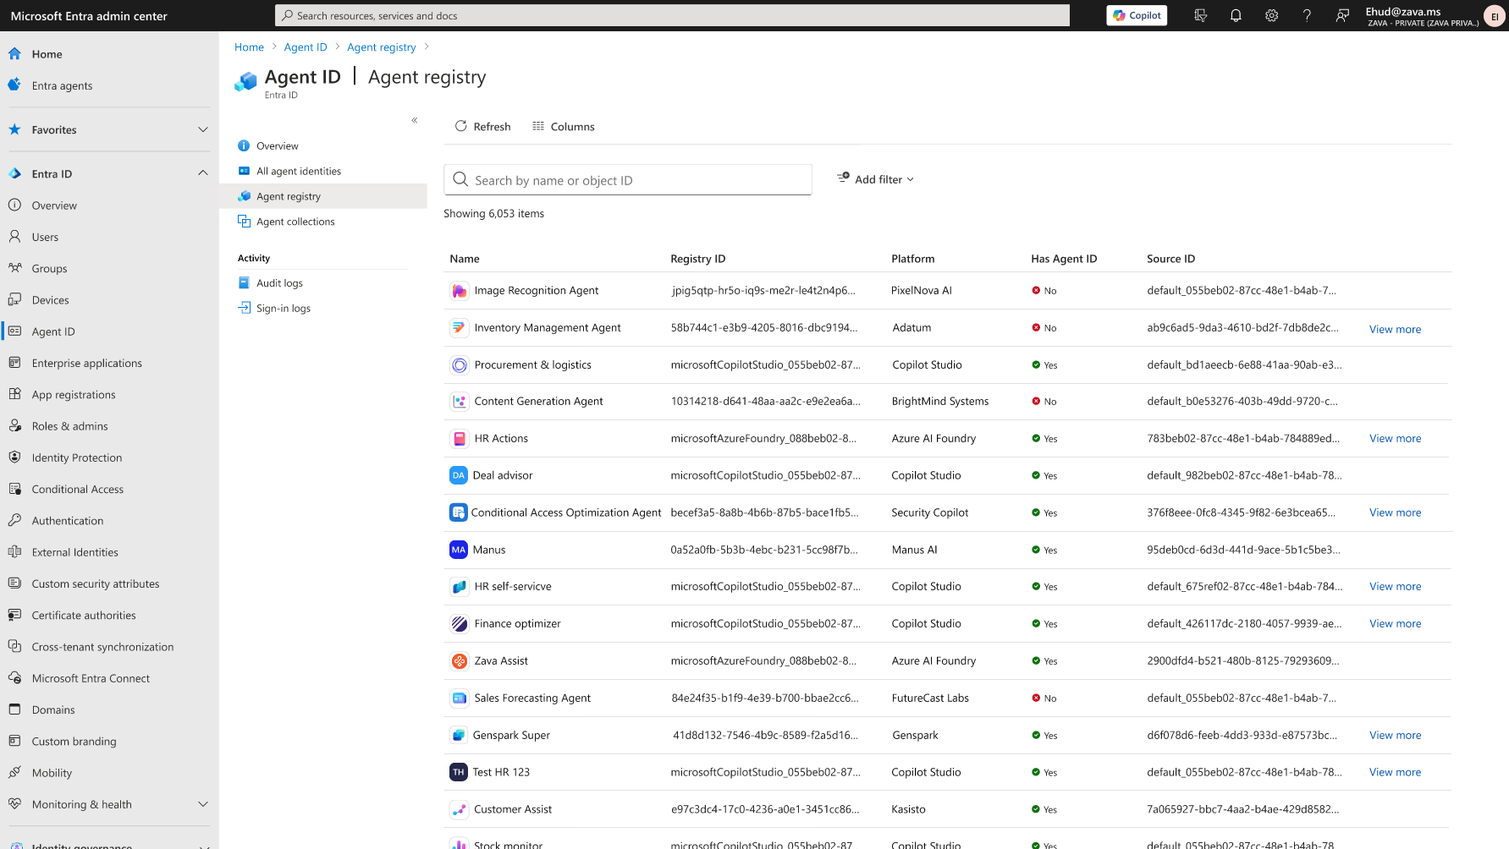
REGISTRY
Registry
Get the complete view of all agents that are being used in your organization, including agents with agent ID, agents you register yourself and shadow agents.

Slide 11







Security
Proactively protect agents by remediating vulnerabilities, understanding attack paths, and filtering out malicious traffic. Detect, investigate and respond to common and novel attacks that target agents.
Security posture
Detection and response
Runtime Defense
Data Security

Slide 12
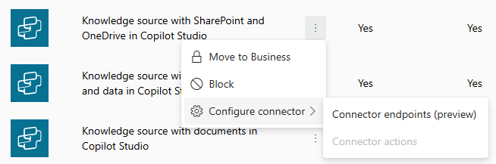
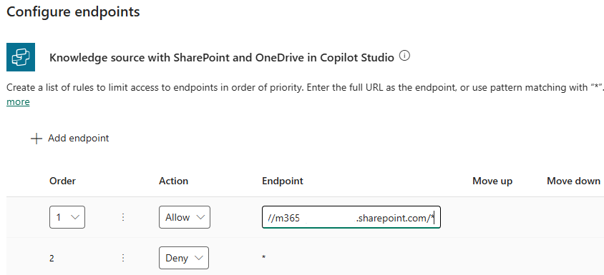
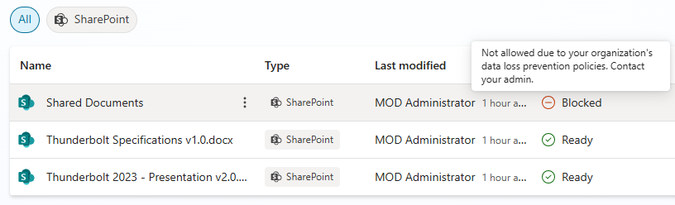
Data Loss Prevention – Connector endpoints (preview)
Power Platform Admin Center
Copilot Studio
Following Copilot Studio connectors supports more granular control allowing admins to specify endpoint URLs by either allowing or denying them
Knowledge source with SharePoint Online and OneDrive
Knowledge source with public websites and data
Supports wildcards

Slide 13
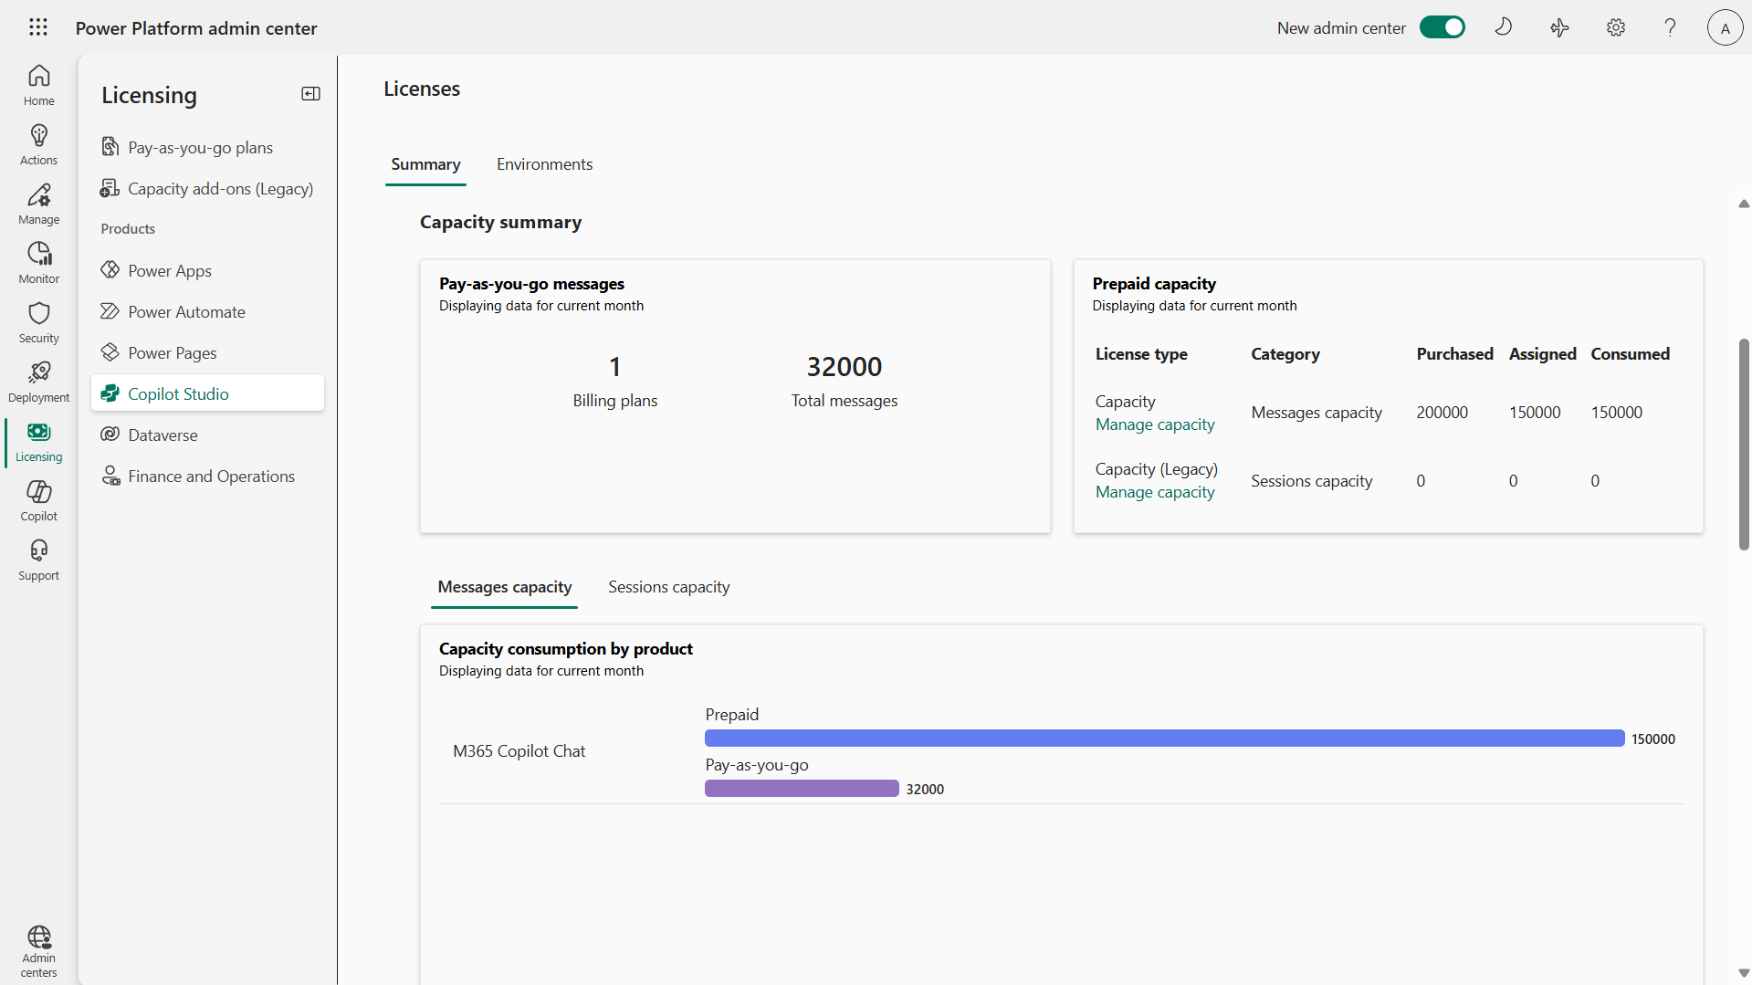
Review credit capacity and consumption in PPAC
Power Platform Admin Center
Copilot Studio
You can monitor usage of Copilot Credits in the Licensing > Products > Copilot Studio
You are provided with details in the credits capacity tab for both prepaid as well as pay-as-you-go consumption for the current month, two previous months and last 12 months
Reports can be downloaded as Excel reports

Slide 14
Discussion
Are you leveraging Agent Inventory available in Copilot Control System?
Are you leveraging Agents Usage reports available in MAC?
General
If you have Copilot Credit Packs and/or pay-as-you-go configured in the tenant, then do you monitor Copilot Credits consumption in MAC and/or PPAC?
Have you installed Copilot Studio Kit which provides additional agent inventory and other useful tools?
Notes:
Discussion opportunity

Slide 15
Thank you

